Slide 1
Graphs

Slide 2
Graphs
A graph is a connected group of vertices and edges.
A vertex is a thing shown in the graph. Sometimes these are referred to as nodes.
An edge is the connection between the things in the graph. Sometimes these are referred to as lines, arcs or links.

Slide 3
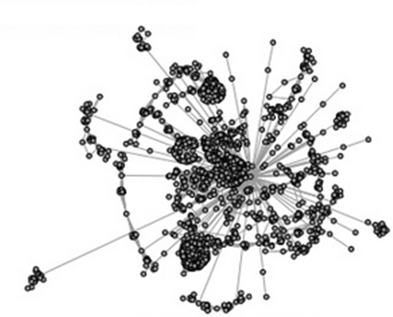
Graphs
Websites!

Slide 4
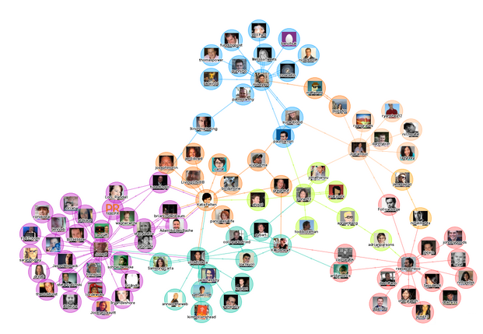
Graphs

Slide 5
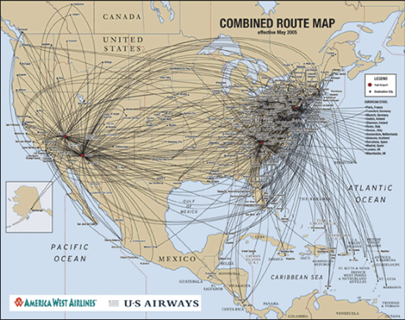
Graphs

Slide 6
Graphs
A
Vertices
A, B, C, D, E
Edges
A-B
A-C
B-D
C-D
C-E
C
B
D
E

Slide 7
Graphs/Bidirectional
A
How do you write an algorithm to check for a path between vertices / nodes?
C
B
D
E

Slide 8
Graphs/Directional
A
How do you write an algorithm to check for a path between vertices / nodes?
C
B
D
E

Slide 9
Graphs
Adjacency Matrix
Vertices
A, B, C, D, E
Edges
A-B
A-C
B-D
C-D
C-E
 | A | B | C | D | E
A | 1 | 1 | 1 | 0 | 0
B | 1 | 1 | 0 | 0 | 0
C | 1 | 0 | 1 | 1 | 1
D | 0 | 0 | 1 | 1 | 0
E | 0 | 0 | 1 | 0 | 1

Slide 10

Graphs
Vertices
A, B, C, D, E
Edges
A-B
A-C
B-D
C-D
C-E
 | A | B | C | D | E
A | 3 | 2 | 2 | 1 | 0
B | 2 | 2 | 1 | 0 | 0
C | 2 | 1 | 4 | 2 | 2
D | 1 | 0 | 2 | 2 | 1
E | 1 | 0 | 2 | 1 | 2

Slide 11
Graphs
Vertices
A, B, C, D, E
Edges
A-B
A-C
B-D
C-D
C-E
Adjacency List
A | B, C
B | A, D
C | A, D, E
D | B, C
E | C

Slide 12
Connections
A
B
C
B | C
A
A
Connection problems are also graph problems as you check vertices and search edges to see if a path exists between two vertices.

Slide 13
Connections
A
B
C
B | C
A
A
Connection problems require you to check for a path between 2 items.
Is A directly connected to C? YES

Slide 14
Connections
A
B
C
B | C
A
A
Connection problems require you to check for a path between 2 items.
Is B directly connected to C? NO

Slide 15
Connections
A
B
C
B | C
A
A
A is directly connected to B and C.
B is directly connected to A.
C is directly connected to A.
Is B connected to C? YES

Slide 16
Connections
A
B
C
D
B | W | E | C
A | E
X | A
T | Q | Z
Is A connected to X? YES
Is A connected to Q? NO

Slide 17
Connections
A
B
C
D
B | W | E | C
A | E
X | A
T | Q | Z
TreeMap<Character, String> map;
TreeMap<Character, Set> map;

Slide 18
Connections
check(String one, String two, String list)
{
if a direct connection exists between one and two
we have a match
else
{
get the current list of connections for one
loop through all of the connections
if you have not checked the current spot
add current spot to list
check to see a connection exists between spot
and the destination ( recursive call )
}
}

Slide 19
DepthFirstSearch
1
0
7
8
3
2
6
4
5

Slide 20
DepthFirstSearch
DFS: Algorithm
DFS(S, G):
Initialize: stack, visited HashSet and parent HashMap
Push S on the stack and add to visited
while stack is not empty:
pop node curr from top of stack
if curr == G return parent map
for each of curr’s neighbors, n, not in visited set:
add n to visited set
add curr as n’s parent in parent map
push n onto the stack
// if we make it this far then there’s no path

Slide 21
DepthFirstSearch
DFS: Algorithm (recursive)
DFS(S, G, visited, parents):
if S == G return
for each of S’s neighbors, n, not in visited set:
add n to visited set
add S as n’s parent in parent map
DFS(n, G, visited, parents)

Slide 22
DepthFirstSearch
1
=pushed/ visited
7
0
8
2
3
6
1
6
2
5
7
4
3
5
0
8
stack

Slide 23
BreadthFirstSearch
BFS: Algorithm
BFS(S, G):
Initialize: queue, visited HashSet and parent HashMap
Add S onto the queue and add to visited
while queue is not empty:
dequeue node curr from front of queue
for each of curr’s neighbors, n, not in visited set:
add n to visited set
add curr as n’s parent in parent map
enqueue n onto the queue
// if we made it here then there’s no path
// subtle changes from DFS Algorithm

Slide 24
BreadthFirstSearch
1
=pushed/ visited
7
0
8
2
3
DONE
6
4
5
6
5
4
2
7
8
3
0
curr:
queue
1

Slide 25
Weighted Shortest Path
Dijkstra: Algorithm
Dijkstra(S, G):
Initialize: PriorityQueue (PQ), visited HashSet, parent HashMap, and distances to infinity
Add (S, 0) onto the PriorityQueue
while PQ is not empty:
dequeue node curr from front of queue
if(curr is not visited)
add curr to the visited set
if(curr == G) return parent map
for each of curr’s neighbors, n, not in visited set:
if(path through curr to n is shorter)
update n’s distance
update curr as n’s parent in parent map
enqueue (n, distance) onto the PQ
// if we made it here then there’s no path

Slide 26
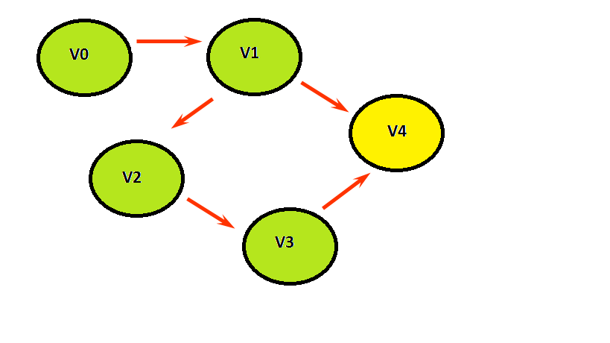
Weighted Shortest Path
0
2
∞
∞
2
V0
V1
6
∞
8
6
1
∞
V4
3
V2
5
∞
1
2
V3
{V4, 6}
{V4, 8}
{V1,2}
{V4, 8}
{V3, 5}
PQ:
curr:
visited:
{V2, 3}
{V0, 0}
{V4, 8}
STOP
V1
V0
V3
V2
V4
V1
V2
V0
V3
V4

Slide 27
Dijkstra Round Two
Dijkstra: Algorithm
For each vertex, keep track of
Cost: The cost of the cheapest path we’ve found to this vertex
Previous: The previous vertex on the cheapest path
Done: A bit telling us whether we have found the shortest path to this vertex yet.

Slide 28
Dijkstra Round Two
V1
4
V2
2
V4
2
1
3
2
2
curr
V0
V3
V5
1
2
source
V0 V1 V2 V3 V4 V5
0
∞
∞
∞
∞
∞
4
3
Cost
3
2
1
Previous
0
0
0
2
3
Done
T
F
T
F
T
F
T
T
F
T
F

Slide 29
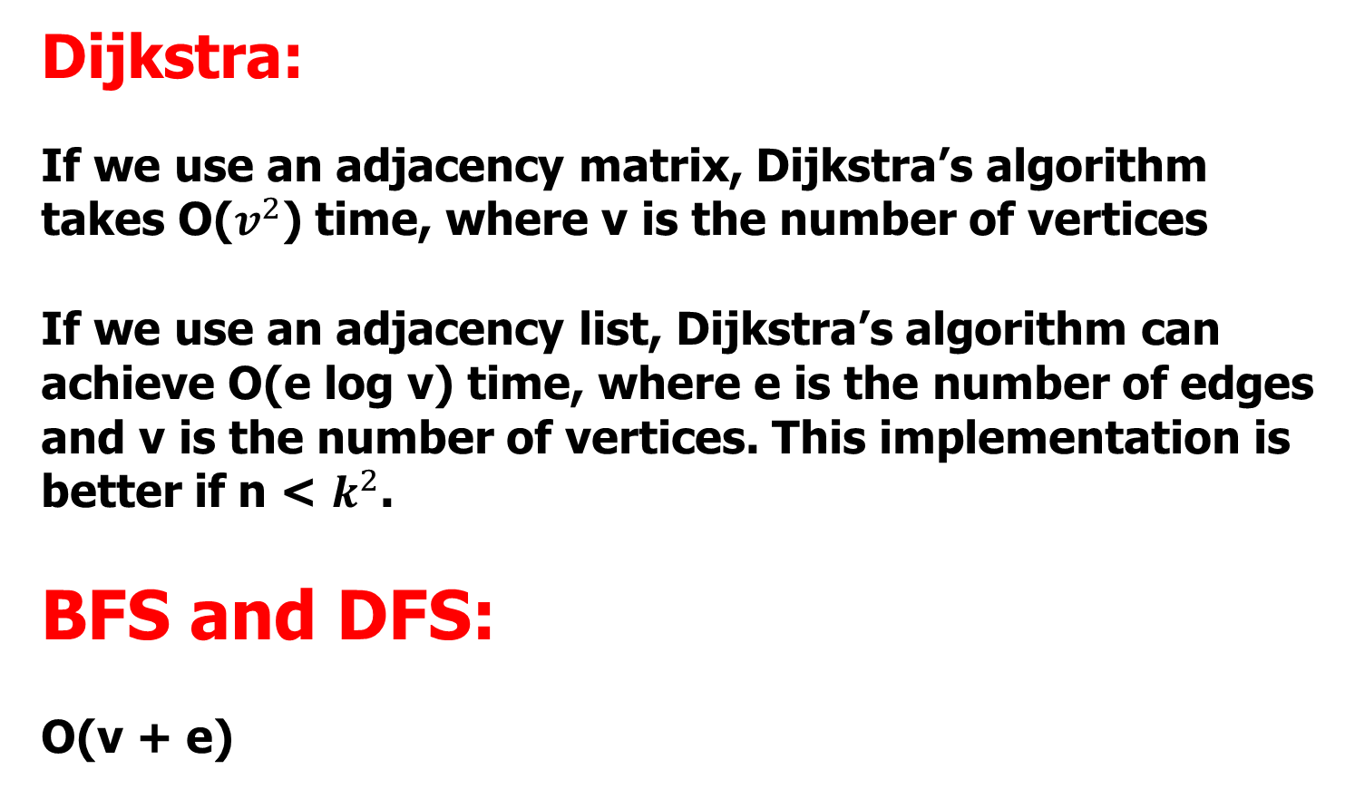
Big O

Slide 30
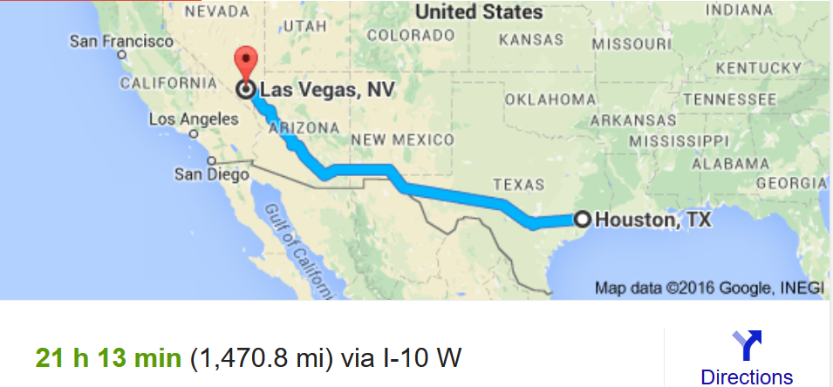
Dijkstra’s Algorithm
We should consider the distance from the target too!
Dijkstra’s only considers distance from source
(1,130 mi) from Oklahoma City to Las Vegas and (442.3 mi) from Houston to Oklahoma City

Slide 31
A* Algorithm
PriorityQueue ordering is based on
f(n) = g(n) + h(n)
where g(n) is the cost or distance from start to vertex and
h(n) is the heuristic estimated cost from vertex n to goal vertex

Slide 32
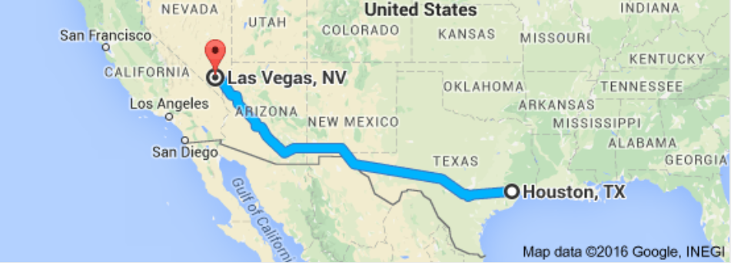
A* Algorithm

Slide 33
Mazes
Mazes are essentially graphs as you have to travel around the maze to see if an exit exists. You will be checking vertices and travelling along the edges.
* * * * * *
* . . . . *
* . . * * *
* S . . . *
* . . . E *
* * * * * *
. are paths
* are walls

Slide 34
Mazes
Maze problems are very common
programming problems.
. * * * * *
. . . . . .
* . . * . .
* . * * * *
* . * . . *
* * . * . .
Other times, you start at 0,0 and must check to see if you can get to length-1, length-1.
. are paths
* are walls

Slide 35
Mazes
void search(int row, int col)
{
if (row >= 0 && col >= 0 && row < maze.length && col < maze[r].length && maze[row][col] = = 1)
{
if (col = = maze[r].length - 1) {
exitFound = true;
}
else {
maze[row][col] = 0; //marking
search(row+1, col);
search(row-1, col);
search(row, col+1);
search(row, col-1);
}
}
}
1 0 1 1 1
0 1 1 1 1
1 1 1 1 0
0 0 0 0 1
0 0 1 1 0

Slide 36
Mazes
In some situations, you want to
make changes to the maze
temporarily. For instance, if you are trying to determine the shortest path, you have to find all
paths and determine which path is the shortest. Each time to you search the maze for a path, the maze must be in its original state.

Slide 37
Mazes
void search(int row, int col)
{
if (row >= 0 && col >= 0 && row < maze.length &&
col < maze[r].length && maze[row][col] = = 1)
{
if (col = = maze[r].length - 1) {
exitFound = true;
}
else {
maze[row][col] = 0; //marking
search(row+1, col);
search(row-1, col);
search(row, col+1);
search(row, col-1);
maze[row][col] = 1; //unmarking ( set it back )
}
}
}

